Slide 1
Reported Crimes Within Montgomery County
Nevra Diker
DATA 205
CRN 32118

Slide 2
Introduction
What is the importance of analyzing crime reporting data?
Enhance community awareness of public safety issues
Support law enforcement with crime prevention efforts (e.g., resource allocation)
Introduces data-driven crime prevention strategies to our community
Research Goal:
Analyze reported crime data in Montgomery County to observe various trends and patterns.
Final Product Goal:
A predictive model that shows 5-year projections of crime reports and the places they were reportedly committed
An interactive dashboard
Notes:
To begin, why is analyzing crime reporting data important? It can enhance community awareness of public safety issues, support law enforcement with crime prevention efforts, and it could introduce data-driven crime prevention strategies to our community. The goal of my project is to analyze reported crime data in Montgomery County to observe different trends and patterns. I wanted to create a predictive model that shows five-year projections of crime reports and the places they were committed and an interactive dashboard that compiles different aspects of my research.

Slide 3



Tools
The tools I used for this project consisted of:
Excel
R Studio
dataMontgomery

Slide 4
Data
Source:
‘Crime’ dataset from dataMontgomery
Summary:
Contains crime reports dating back to July 1st, 2016
Postings are updated daily to dataMontgomery
Data is provided by the Montgomery County Police Department
Contents:
The crime that was reportedly committed
The city in which the crime occurred (‘City’)
Place the crime occurred (‘Place’)
The agency the crime was reported to (‘Agency’)
The time and date the report was made (‘Start_Date_Time’)
Notes:
I used the Crime dataset from dataMontgomery which is provided by the Montgomery County Police Department. It contains crime reports ranging from July 1st, 2016, to present day and it is updated daily. It has 30 columns such as …

Slide 5
Data Cleaning
New Column:
Created ‘Year’ column using the ‘Start_Date_Time’ column
Renamed Columns (‘Crime Name’):
‘Category’: the broad type of crime (Crime Against: Property, Society, Person, Not a Crime)
‘Crime’: the crime that was reportedly committed (e.g., Simple Assault)
‘Description’: detailed explanation of the crime (e.g., ‘Assault – Simple’ or ‘Assault – 2nd Degree’)
Extracted Values from ‘All Other Offenses’
Notes:
To begin my exploration process, I had to clean up parts of my data. I created a new column called Year and I renamed a few columns because they were a bit vague. The first one I renamed was Crime Name1 which had data about the broad type of crime which could be crime against property, society, person, or not a crime. So, this became category. Then I renamed Crime Name2 to crime because this one contains information about the crime that was reported. And Crime Name3 was renamed to description because it provides a more detailed explanation of the crime that was reported. There was also a value called ‘All Other Offenses’ in the crime column which was used as a bit of an umbrella term. About 90 different crime fell under this term, so I extracted the data from the description column and put it into the crime column.

Slide 6
Reported Crime vs. Committed Crime
Just because the crime was reported doesn’t mean it was committed.
Not all crime reports are true:
Mistake filings
Lying
Not all reported events are crimes:
Runaway
Mental Illness – Emergency Petition
Sudden Death
Notes:
It’s important to point out the difference between reported crime and committed crime. Just because the crimes were reported, doesn’t mean that they were actually committed. I would also like to point out that some of these crime reports might not be true. There could be mistake filings; so, let's say that someone lit up fireworks, but you thought they were gun shots and filed a report. Obviously, there’s no crime there, but the report was filed. Some people could be lying about their reports. And not all reported events are what we would consider to be a crime. This includes things like runaways, an emergency petition for some with a mental illness, or even sudden death.

Slide 7
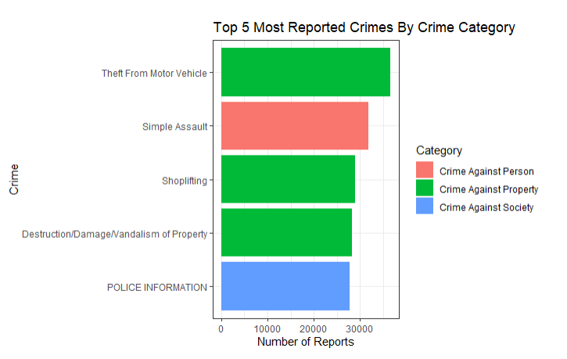
Reported Crimes
Summary:
150 listed crimes
Extracted values from ‘All Other Offenses’
Four different categories of crime
Notes:
The dataset has about 150 listed crimes. Looking at the bar plot, which shows us the top five most reported crimes by category, we can see that theft from motor vehicle is the most reported crime. Before I extracted the data from the ‘All Other Offenses’ value, that was the crime that was reported the most. If you look down to the police information crime, you will notice that it’s in all caps. This is because it comes from ‘All Other Offenses’.

Slide 8
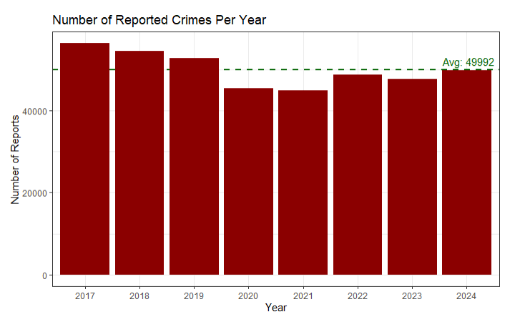
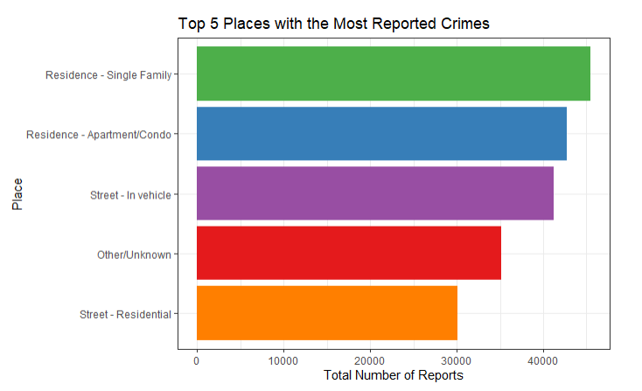
Crime Reports and Locations
Notes:
I created a few visualizations to tackle the basic statistics. The graph on the left shows us the number of reported crimes per year. We can see that the average number of reported crimes is about 50,000. As you may have noticed, there is a decrease in reported crimes during 2020 and 2021. This is most likely due to the COVID-19 pandemic and the quarantine we were under. The graph on the right shows us the top five (out of 100) places with the highest number of reported crimes; the highest being ‘Residence – Single Family’.

Slide 9
Public Safety Agencies
Contains data from 6 public safety agencies:
‘GPD’: Gaithersburg Police Department
‘MCFM’: Montgomery County Fire Marshall
‘MCPD’: Montgomery County Police Department
‘MCSO’: Montgomery County Sheriff’s Office
‘RCPD’: Rockville City Police Department
‘TPPD’: Takoma Park Police Department
Notes:
The dataset contains data from six public safety agencies. The agencies are….

Slide 10
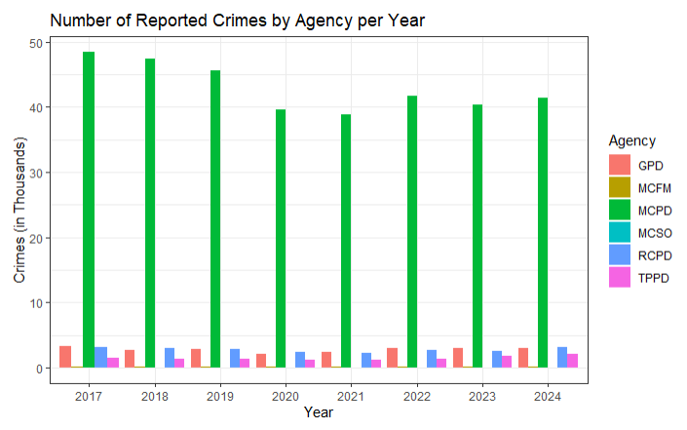
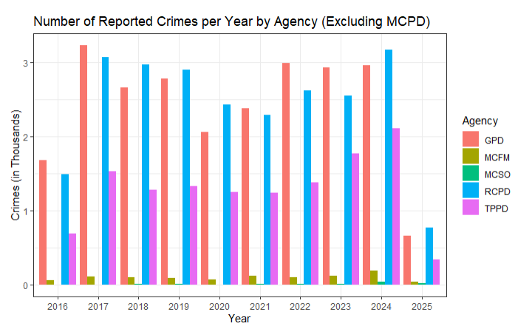
Highest Yearly Crime Reports
Which agency has the highest yearly crime reports?
Notes:
So which agency has the highest yearly crime reports? Looking to the graph on the left, which shows us the number of yearly reports by agency, we can see that MCPD has the highest total by far. You may have noticed that the MCPD data completely dwarfs the rest of the agencies. So, the graph on the right shows the same analysis, but without the MCPD agency. Again, we can see that decrease in reports around 2020 and 2021 in both graphs due to COVID.

Slide 11
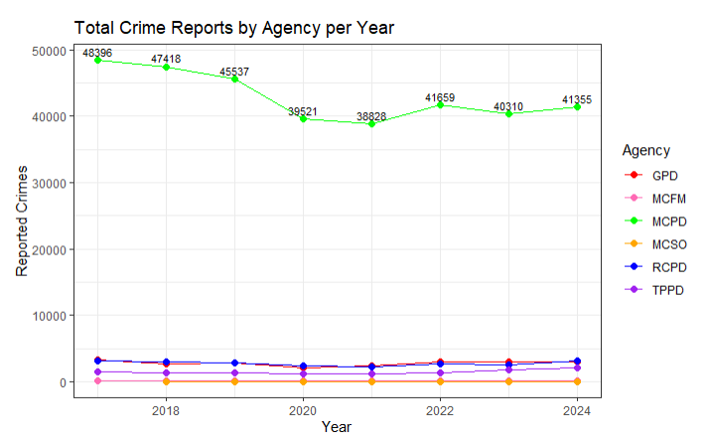
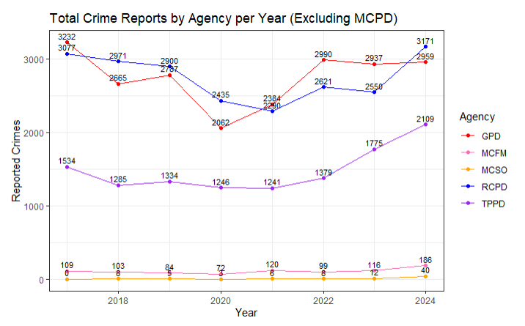
Crime Reports by Agency
Actual yearly crime reports by agency:
Notes:
If we look to the graph on the left, we can see the actual yearly crime reports by agency. Just like the last slide, I created a second visualization on the right, which is the same data, but it excludes MCPD. These agencies typically see less than 3000 crime reports per year.

Slide 12
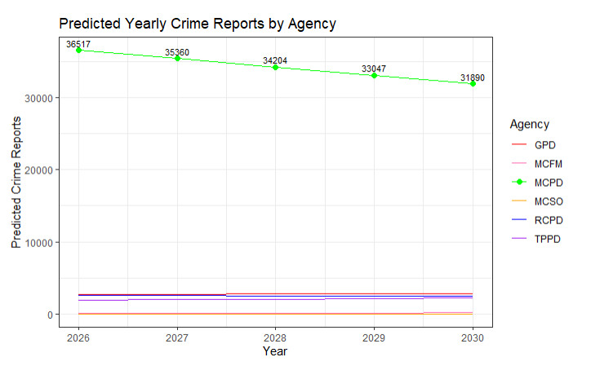
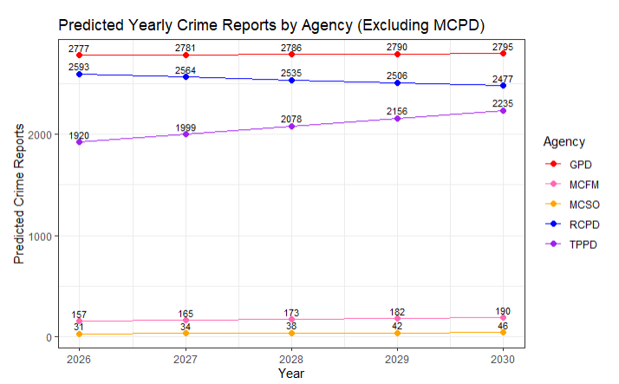
Predicted Crime Reports by Agency
5-year prediction of yearly crime reports by agency (linear regression model):
Notes:
Using a linear regression model, I created a five-year prediction of yearly crime reports by agency. This model predicts how the number of reported crime will change over time for each agency. On the left graph, we can see that MCPD is predicted to see a decrease of crime reports. On the right graph, which doesn’t include MCPD data, we can see that most of these agencies won’t see much of a change in crime reports. However, there is a slight increase for the Takoma Park Police Department. I would also like to mention that this dataset barely has 10 years of data, so these predictions most likely won’t be as accurate as a prediction that uses 15 or 20 years worth of data.

Slide 13
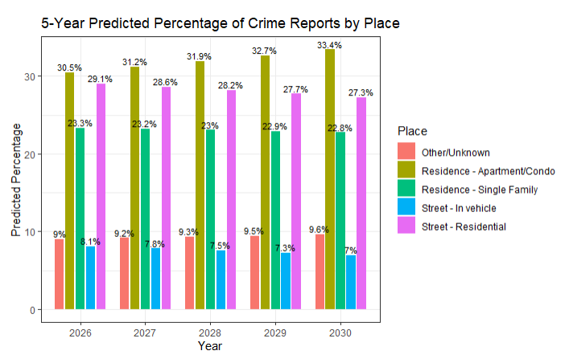
Predicted Percentage of Crime Reports By Place
5-year prediction of the predicted percentage of crime reports by place (linear regression model):
Notes:
In association with the previous predictions, using a linear regression model, I created a five-year prediction of the percentage of crime reports by place. We can see that the ‘Residence – Apartment/Condo’ is consistently the top location for reported crimes, and it’s share in the overall percentage of crime reports is predicted to increase. Whereas ‘Street – Residential’ is predicted to decrease. The other three places stay constant throughout the 5 years.

Slide 14
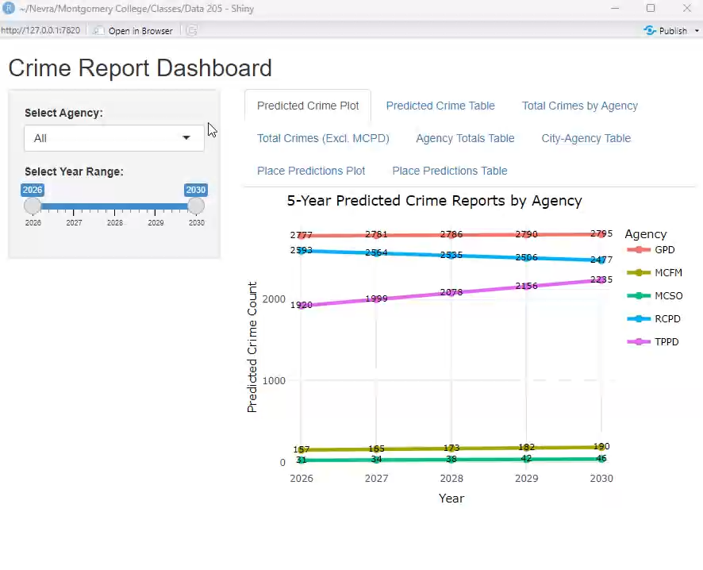
Shiny Dashboard
Notes:
As part of my final product, I wanted to create a simple dashboard in R Studio using the Shiny package. I compiled all of the interactive graphs and tables that I created just so it would be easier for user to look through it. For the sake of time, I filmed a short video showing some of those visualizations and how the dashboard works. So, for the predicted crime plot, I used the slider on the left to select Gaithersburg Police Department, and I shortened the range to 2027 to 2030. Then, I have that same data, but in table form. And then I have a scatterplot of the total crime reports by agency which gives you some more information about the year and the amount of reports when you hover over a data point.

Slide 15
References
Montgomery County, MD. “Crime: Open Data Portal.” Crime | Open Data Portal, 6 May 2025, data.montgomerycountymd.gov/Public-Safety/Crime/icn6-v9z3/about_data.
“Montgomery County, MD.” Montgomery County Maryland, montgomerycountymd.gov/. Accessed 6 May 2025.
“Learn R.” Codecademy, Codecademy, www.codecademy.com/learn/learn-r. Accessed 7 May 2025.
“Forecast.” RDocumentation, www.rdocumentation.org/packages/forecast/versions/8.23.0. Accessed 7 May 2025.
Shiny for R :: Cheatsheet, rstudio.github.io/cheatsheets/html/shiny.html?_gl=1%2A13qc3lq%2A_ga%2AMTg5MzQyMzY0Ny4xNzQ0MzI1MTE1%2A_ga_2C0WZ1JHG0%2AczE3NDY2MDExNDAkbzIkZzAkdDE3NDY2MDExNDAkajAkbDAkaDA. Accessed 7 May 2025.

Slide 16
Acknowledgements
Thank you to:
Professor Valentine
My DATA 205 classmates
Professor Alraee
Professor Saidi
Notes:
I would like to thank Professor Valentine for guiding me through this entire process. Thank you to my DATA 205 classmates for feedback and advice. Thank you to Professor Saidi and Professor Alraee for teaching me the foundations of Data Science. And an extra thank you to Professor Alraee for helping me troubleshoot some of my code.

